Slide 1

Kentucky Legal Research

Slide 2
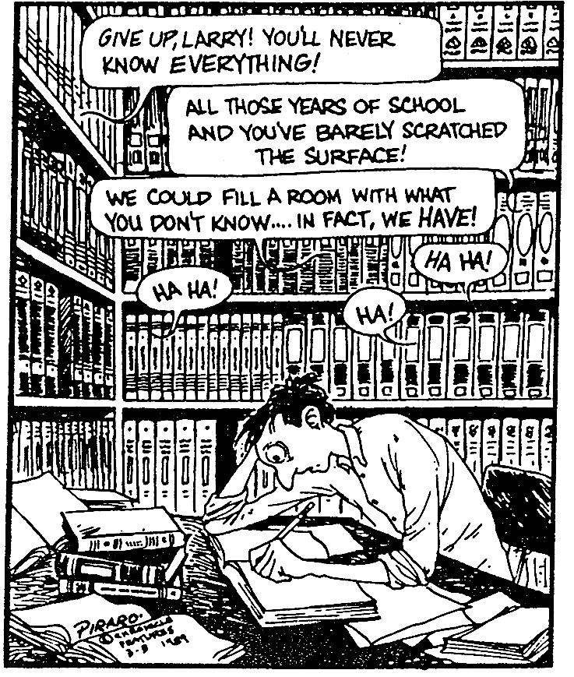
Sources to Consult:
Print
C.A.L.R.
  Casemaker
  Fastcase
  Bloomberg Law
  Westlaw
  Lexis
  LawReader.com
  FREE websites

Slide 3

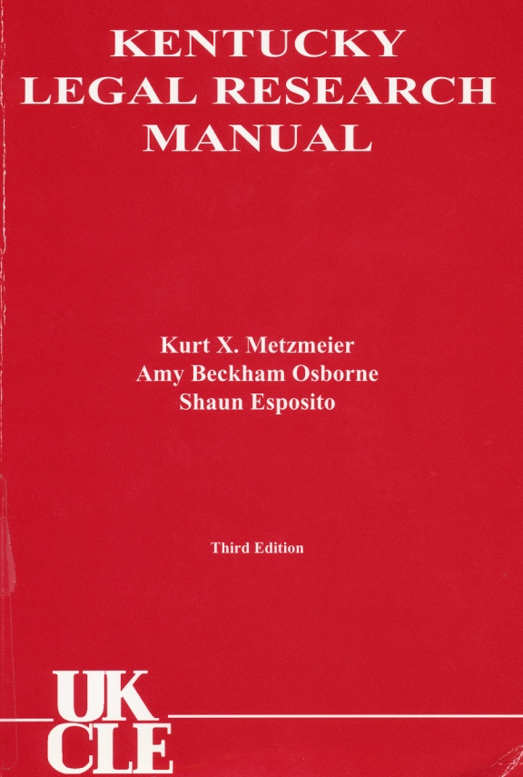
KY Legal Research Manuals
Constitution
Judiciary + Court Rules
Kentucky Statutes + Superseded Codes
Local Government
Kentucky General Assembly & legislative process
Administrative Law
Legal Ethics
Treatises + Practice Books
Citation Rules

Slide 4
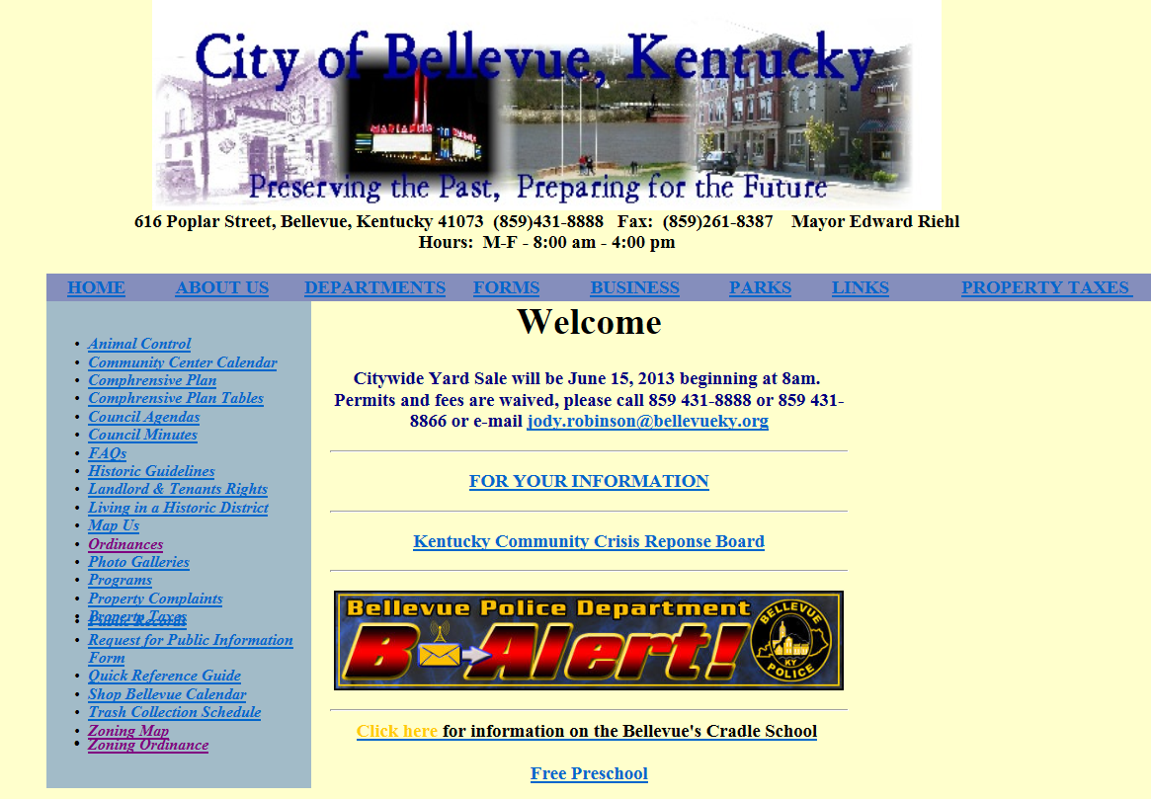

Slide 5
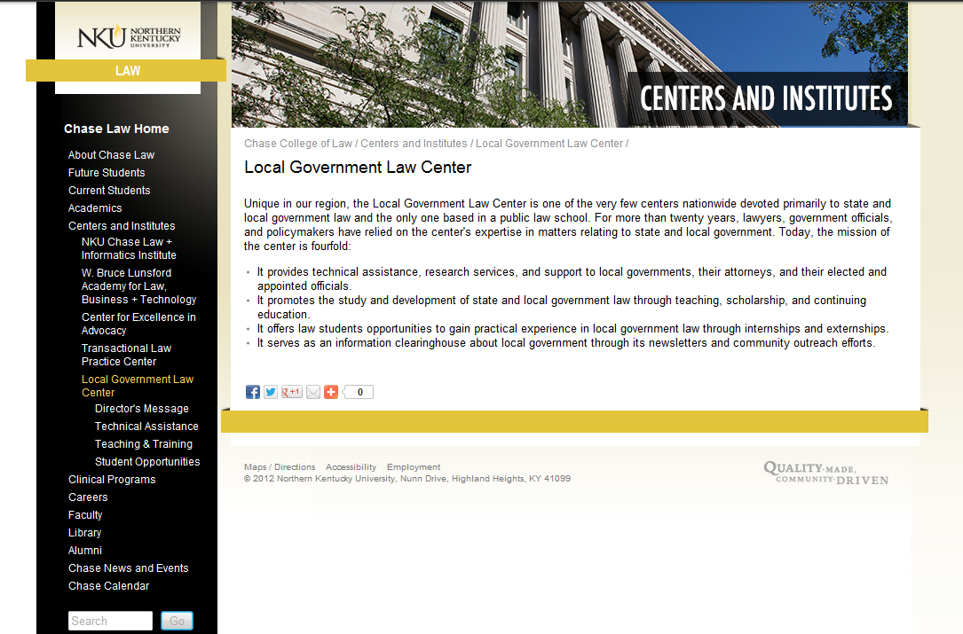

Slide 6
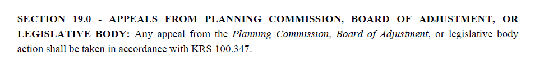
What now??

Slide 7

Kentucky Revised Statutes (KRS)
Print – OFFICIAL!
  Michie (Lexis Publishing)
  Banks-Baldwin (West Publishing)
C.A.L.R.
  CasemakerX
  LRC’s website

Slide 8
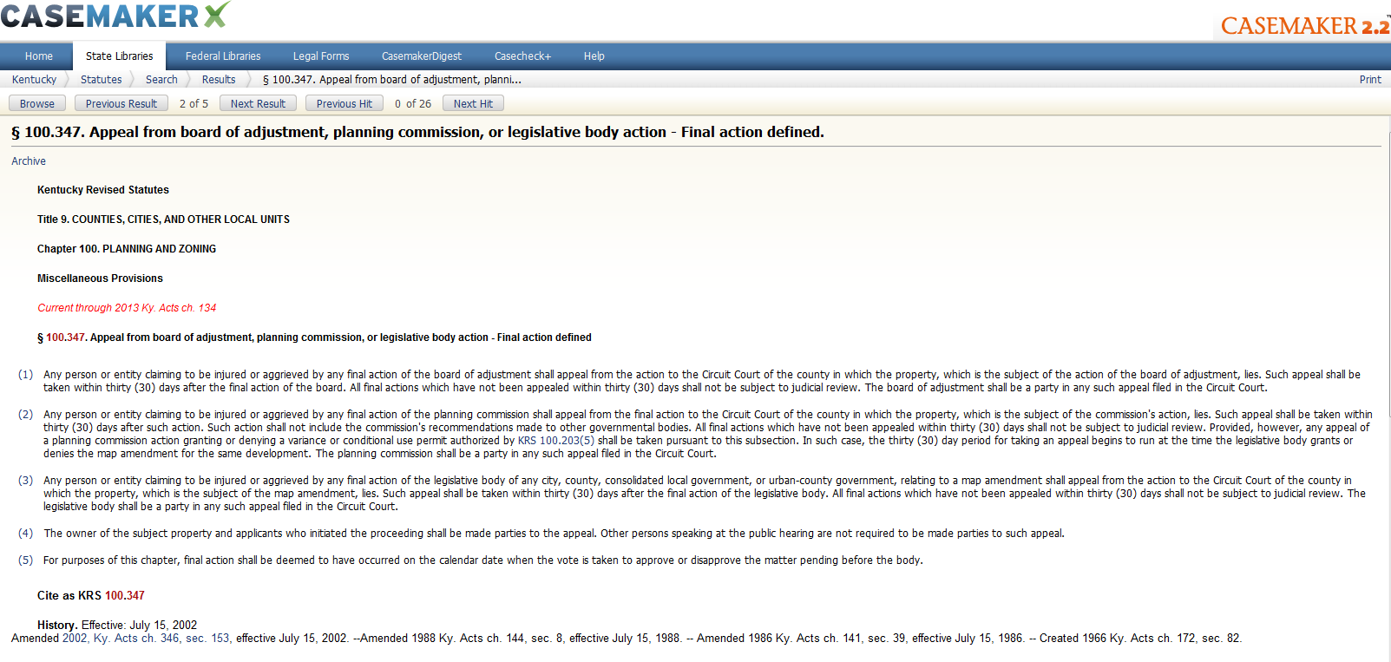

Casemaker – KRS 100.347
FREE,
But NO
Annotations

Slide 9
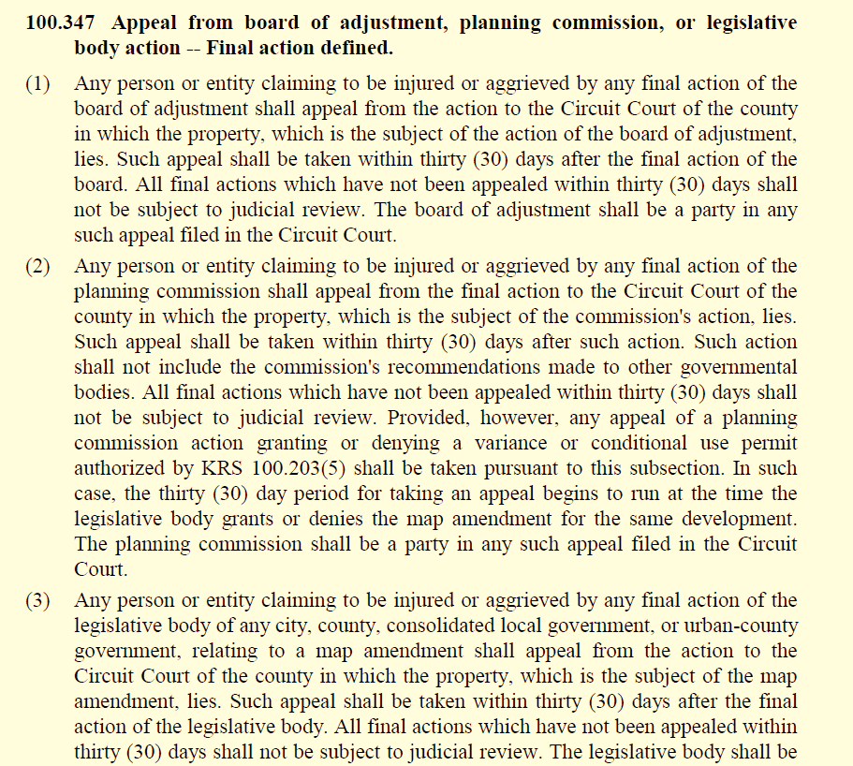
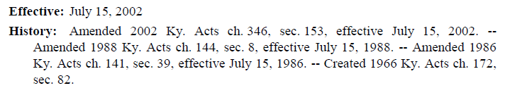
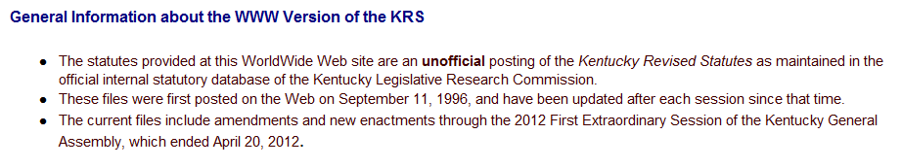
KRS 100.347 via LRC Website

Slide 10
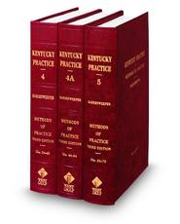
Kentucky Practice Series
Domestic Relations
Methods of Practice
Probate Practice
Tort Law
Trial Practice Materials
Appellate Practice
Rules of Civil Proc. & Forms
Criminal Prac. & Proc.
Substantive Crim. Law

Slide 11

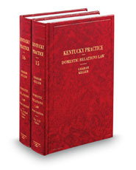
Further Research for Appeal:
Real Estate & Related Treatises
Text of Statute
Forms
Court Procedures
Case Citations
Commentary
Estimate Costs
Checklists

Slide 12
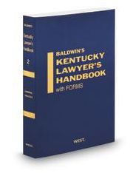




Other Treatises & Resources

Slide 13
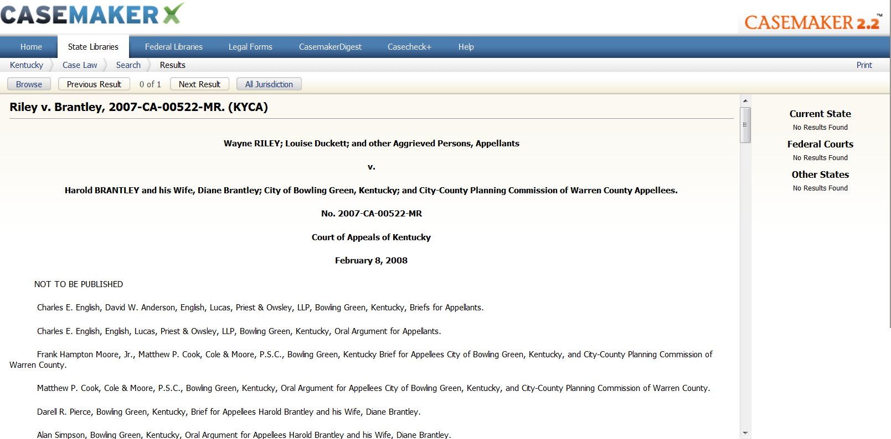
Onward to cited case law…

Slide 14
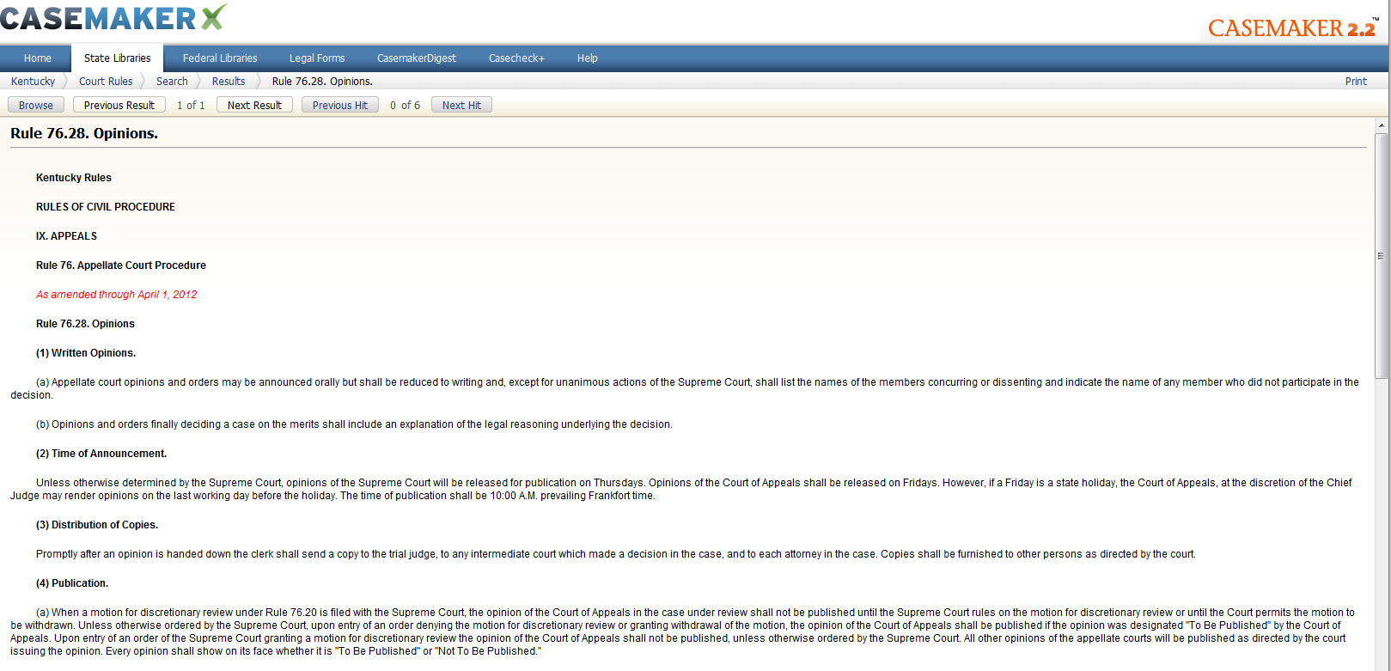
KY Rules of Civ. Pro. 76.28(4)(c)
(c) Opinions that are not to be published shall not be cited or used as binding precedent in any other case in any court of this state; however, unpublished Kentucky appellate decisions, rendered after January 1, 2003, may be cited for consideration by the court if there is no published opinion that would adequately address the issue before the court. Opinions cited for consideration by the court shall be set out as an unpublished decision in the filed document and a copy of the entire decision shall be tendered along with the document to the court and all parties to the action.

Slide 15
Getting ready for court…Court Rules
Print Statutes
Casemaker
Court’s own website
Lexis & Westlaw
Westlaw Public Patron Access
Citation: KY Rules of Civ. Pro. - Rule 76.12(4)(g)

Slide 16
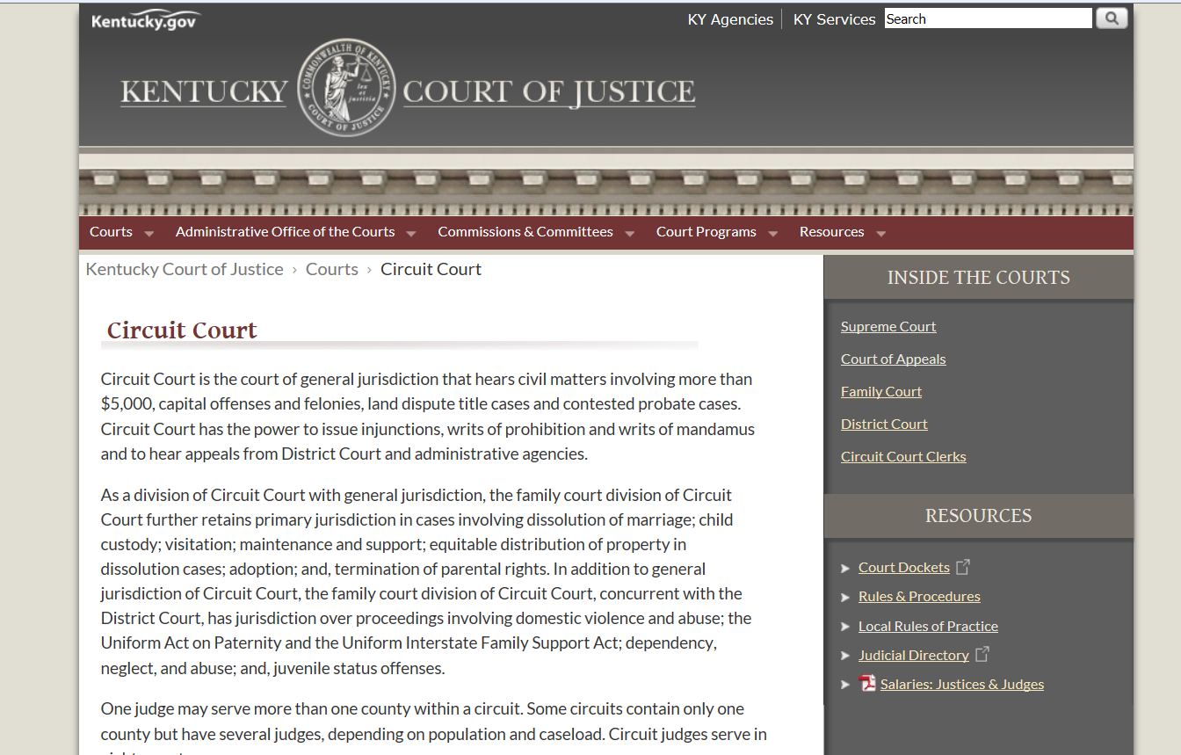
Court Rules cont…
http://courts.ky.gov/

Slide 17
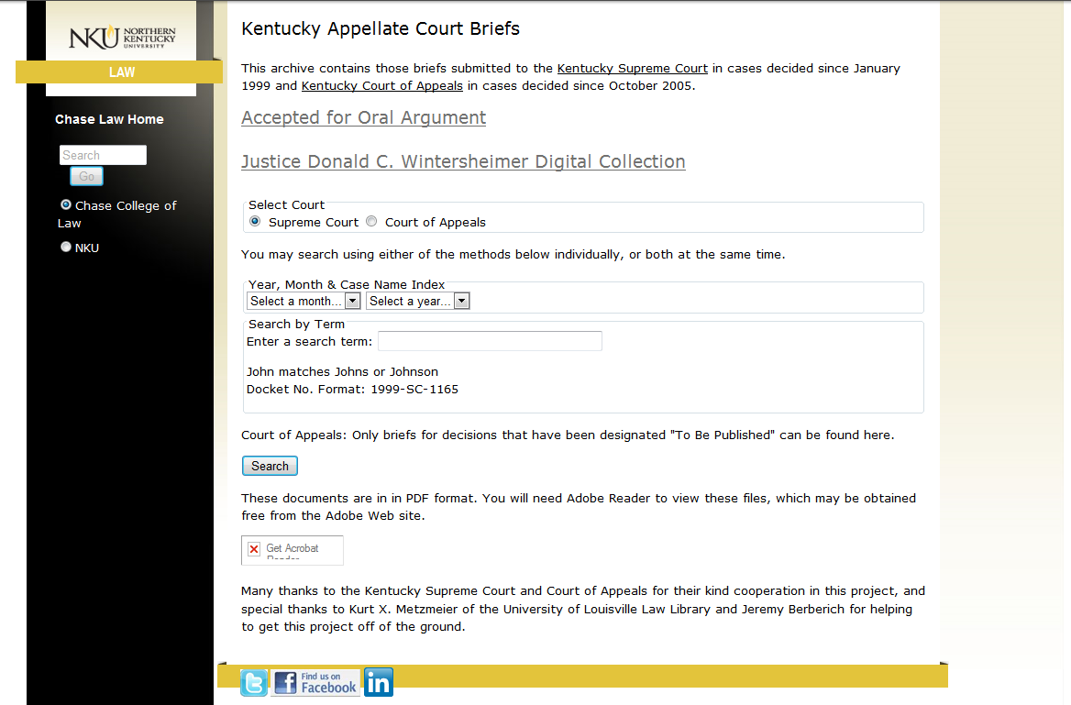
KY Appellate Court Briefs project

Slide 18
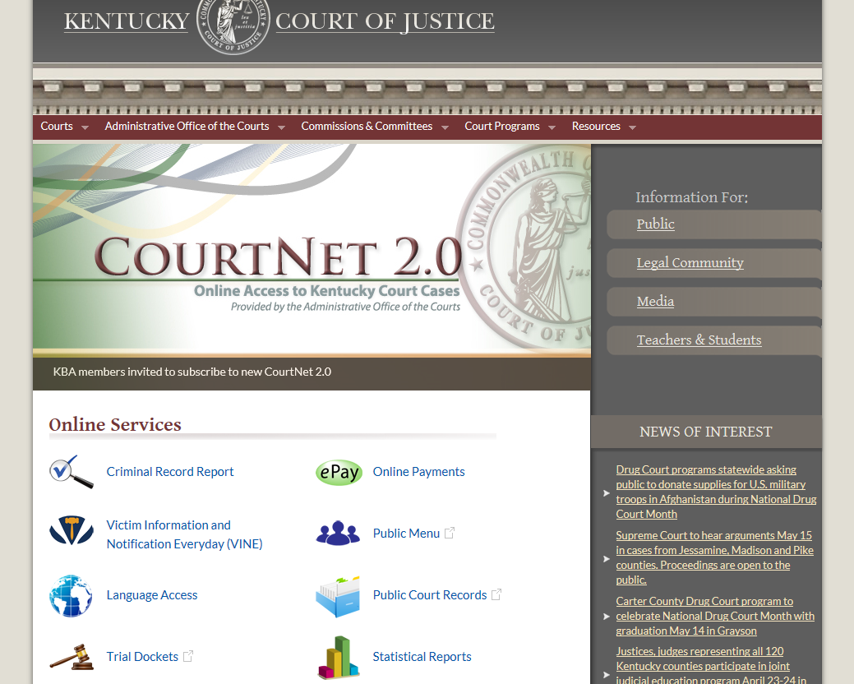
Awaiting court…Dockets
http://courts.ky.gov/

Slide 19
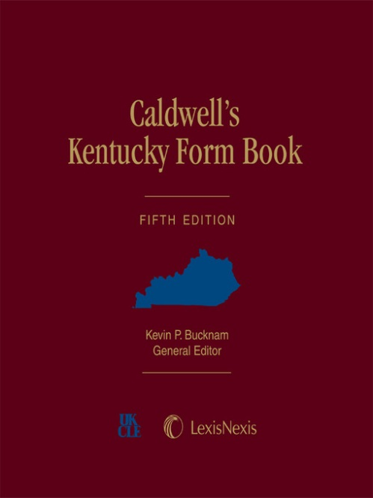
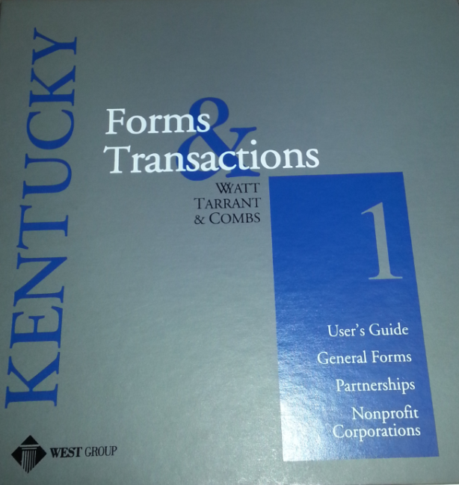
Additional Materials…KY Form Books
Kentucky Forms & Transactions (Print & WL)
Caldwell’s Kentucky Form Book (Print & LN)
Casemaker (Legal Forms library – some fees)
KY Practice (Print & WL)

Slide 20
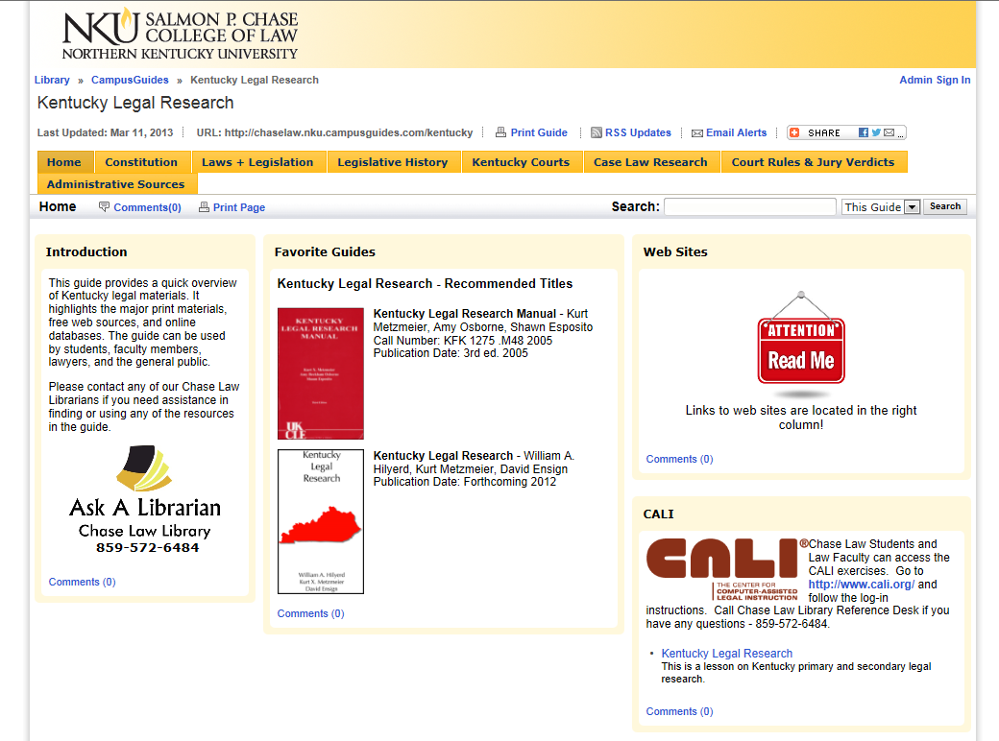
Research Help on the Web:
Chase’s KY Legal Research Campus Guide

Slide 21
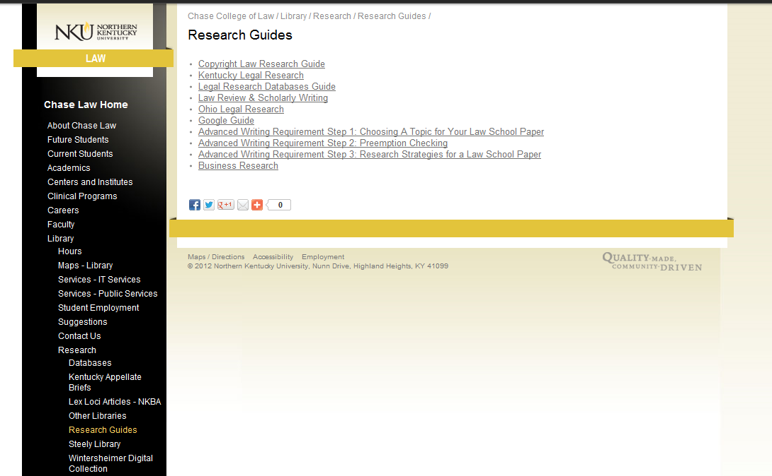
Research Help on the Web:
Chase Research Links

Slide 22
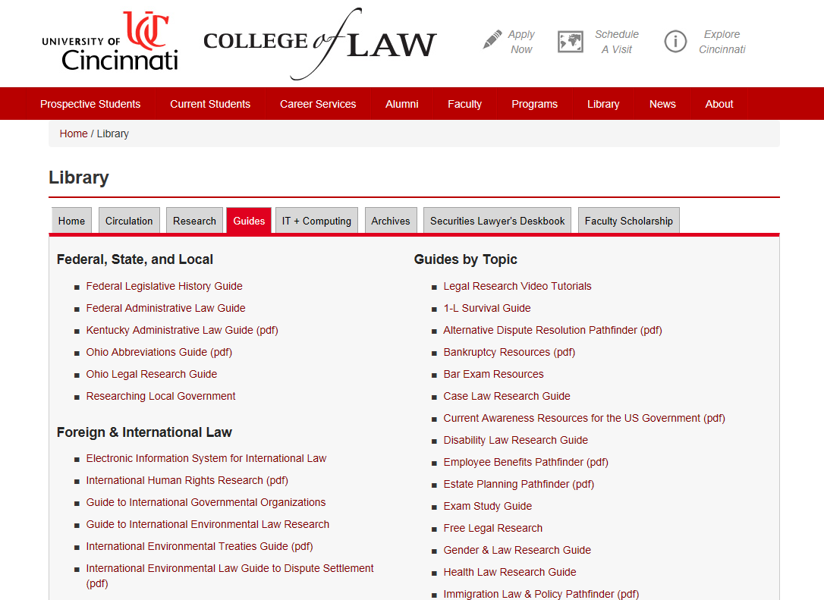
Research Help on the Web:
UC Research Guides

Slide 23
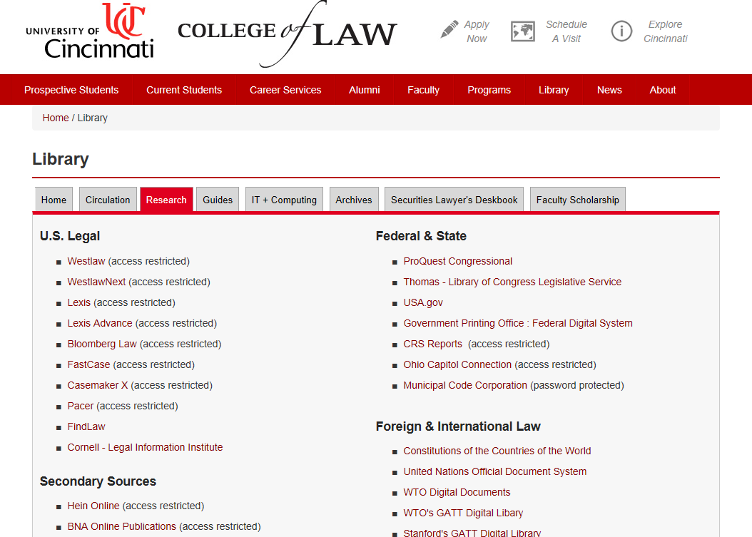
Research Help on the Web:
UC Research Links

Slide 24

Don’t forget about the Local Libraries
Chase Law Library
University of Cincinnati Law Library
Hamilton County Law Library
Boone, Campbell, & Kenton County Public Libraries
Public Library of Cincinnati & Hamilton County

Slide 25
Remember…
ASK FOR
Chase Law Library
  Ref. Desk 859.572.6484
  WL Patron Access (in library)
  Print Coll. & Databases
University of Cincinnati Law Library
  Ref. Desk 513.556.8078
  Print Coll. & Databases
Hamilton County Law Library
  PH: 513.946.5300
  Print Coll. & Databases

